Slide 1
Hardware: Locomotions & Mechanical Design (2-ACTUATORS)
Task for 11 Apr 22 (Online Lecture)
MUHAMMAD NAZHAN BIN RAMLI 1816847

Slide 2
Hardware Components that move the Robots i) Basic Motion Principle ii)Hardware Components (Specification,Brands and Price)
1) Stationary Robots
a) Omron forpheus robot
2) Wheeled Robots & Tracked Robots
a) Single wheel BB-8
b) 4WD Omni-Directional Mobile Robot
c) Wall Climbing Robot (Metal vs Wall vs Glass)
3) Legged
a) Humanoid Robot (BIOLOID)
4) Swimming
a) Fish robot
b) Underwater glider robot
5) Others
a) Kilobot

Slide 3
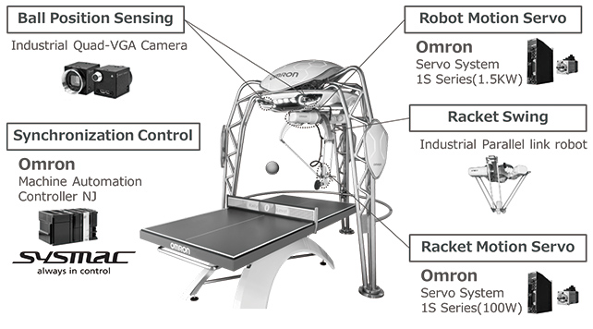
1) Stationary Robots a) Omron forpheus robot

Slide 4
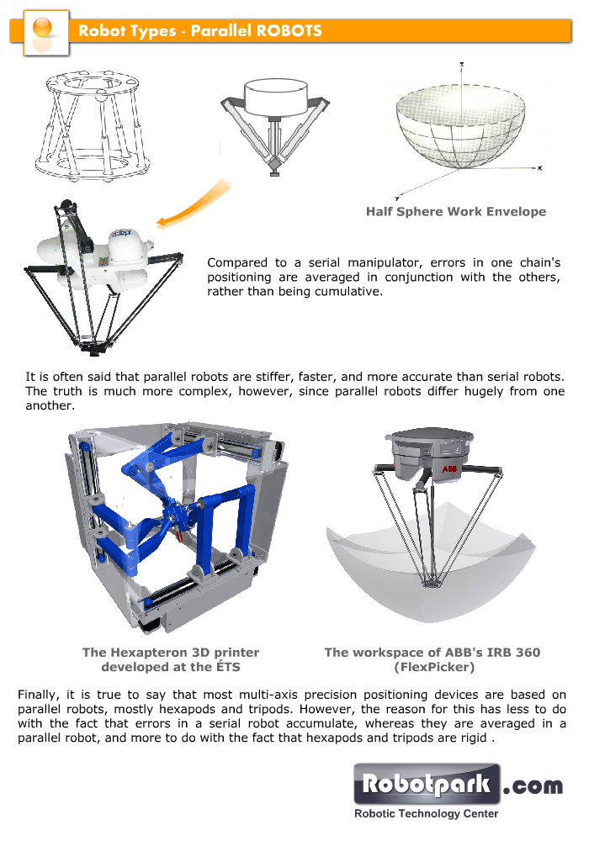
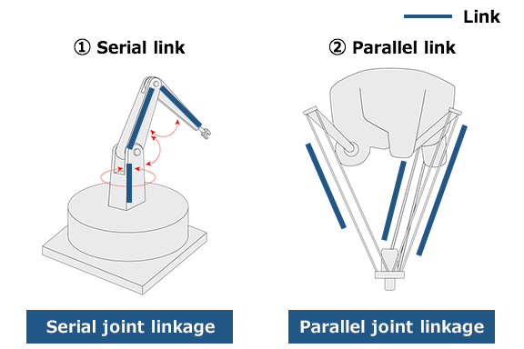
i) Basic Motion Principle
Industrial Parallel Link Robot

Slide 5
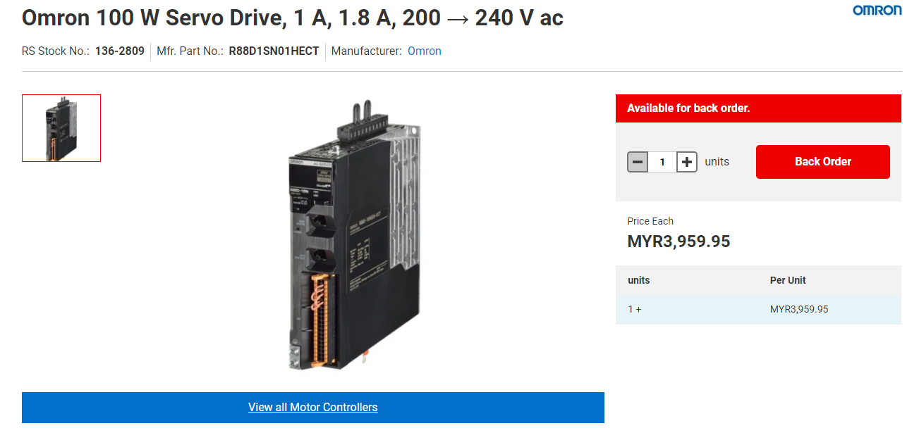
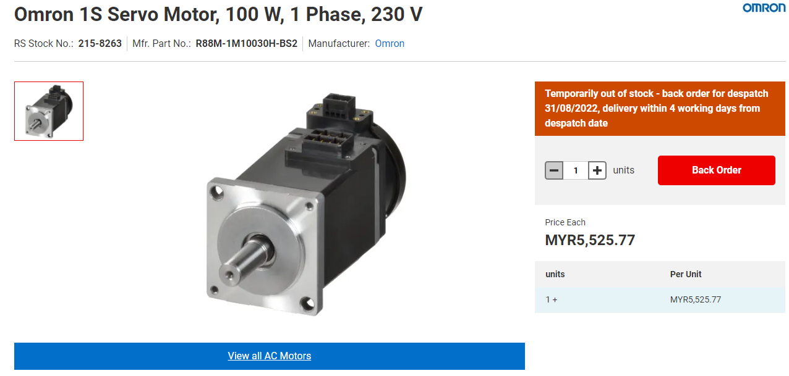
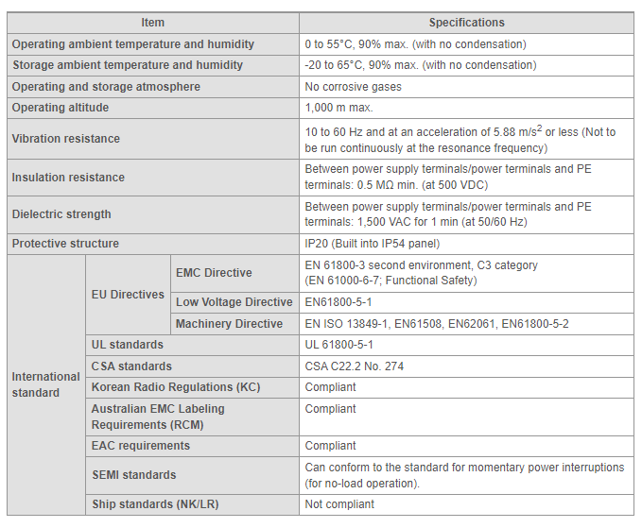
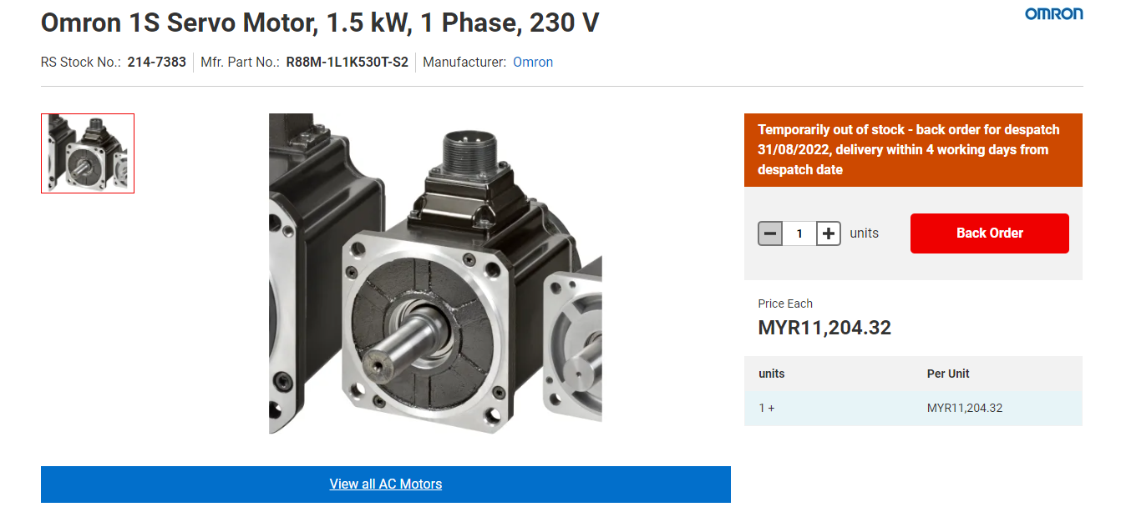
ii) Hardware Components
Omron 1S Servo Motor
Brand : Omron
Price : RM 5000 – RM 11,000

Slide 6
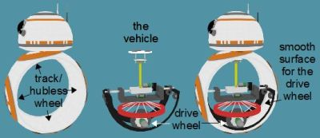
2) Wheeled Robots & Tracked Robots a) Single wheel BB-8

Slide 7
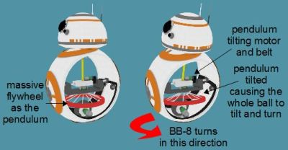
i) Basic Motion Principle
Hubless Wheel Drive
Turning is accomplished in the same manner as with the axle drive. The vehicle has a section that hangs down like a pendulum, and can be swung to either side. The mass of the pendulum illustrated here is a heavy flywheel (colored red). A motor can then swing that mass to either side to tilt the ball. And just as with the axle drive, tilting the ball causes the entire robot to move in the direction of the tilt.
Stabilization is done using a combination of techniques similar to the axle and hamster drives. For back and forth stability the vehicle in the track moves back and forth, countering wobble. And for side-to-side stability, the suspended mass is moved from side-to-side to counter that wobble.
The massive flywheel can also be rotated rapidly around its own axis, which causes the rest of the BB-8 to rotate in the opposite direction, allowing it the added trick of turning on the spot.

Slide 8
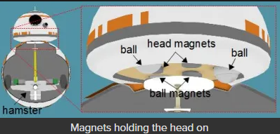
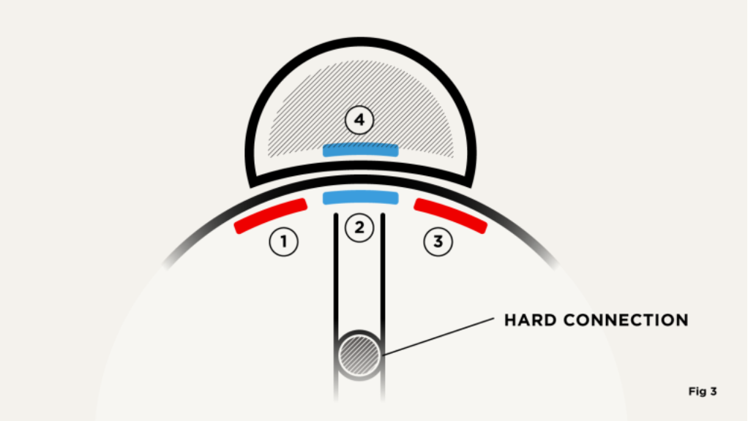
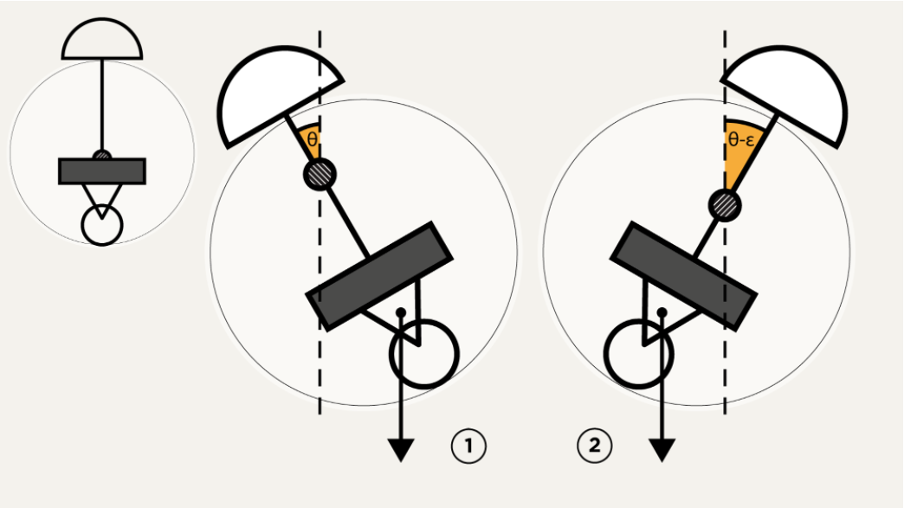
Movement of the Head
Calibration is super important for the head movement since It follows the tilted angle

Slide 9
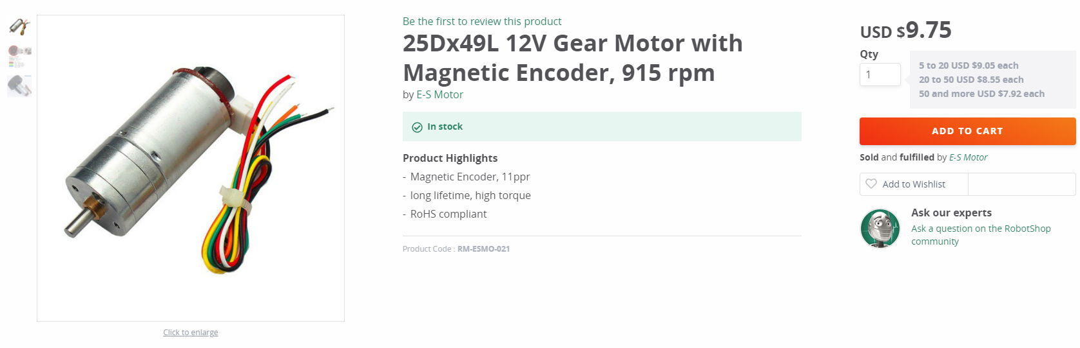
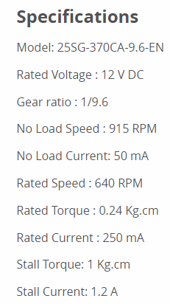
ii) Hardware Components
DC Motor with Magnetic Encoder
Brand : E-S Motor
Price : RM 41
A high torque motor is required to move the robot especially when it stuck to something. The magnetic encoder is used to give the feedback of the true motor speed and to determine the robot position.

Slide 10
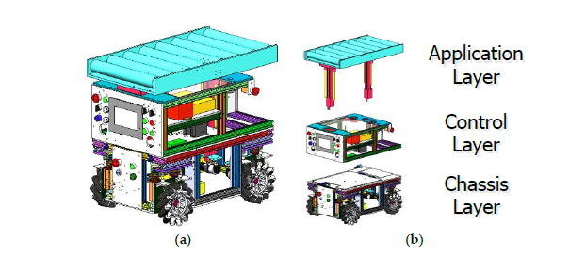
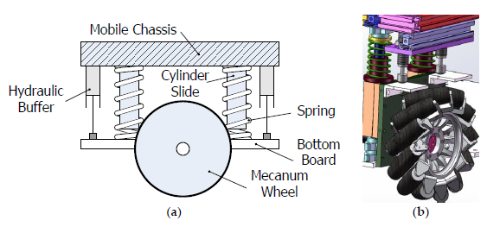
2) Wheeled Robots & Tracked Robots b) 4WD Omni-Directional Mobile Robot

Slide 11
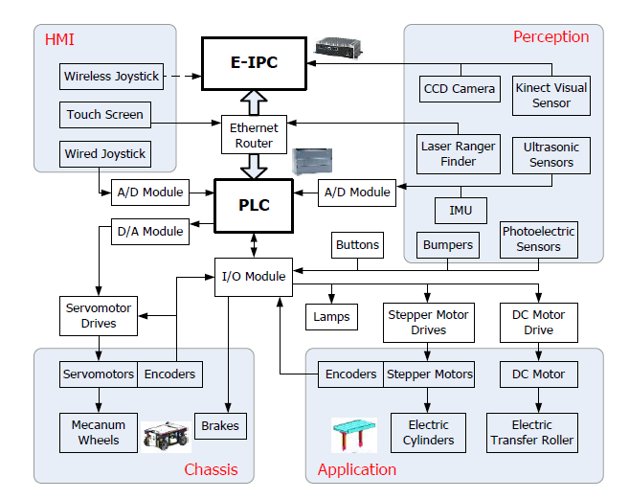

Slide 12
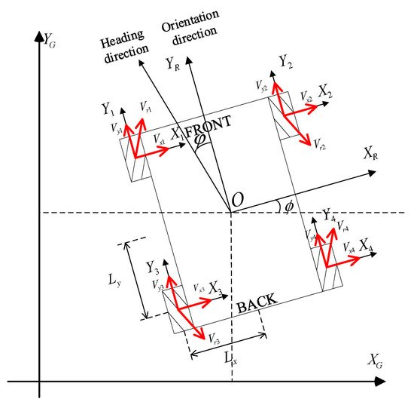
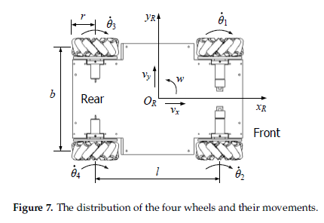
i) Basic Motion Principle
Omni-Directional Wheel Movement
The locomotion of the robot is based on the mecanum wheels that follows the direction of the robot and its angle

Slide 13
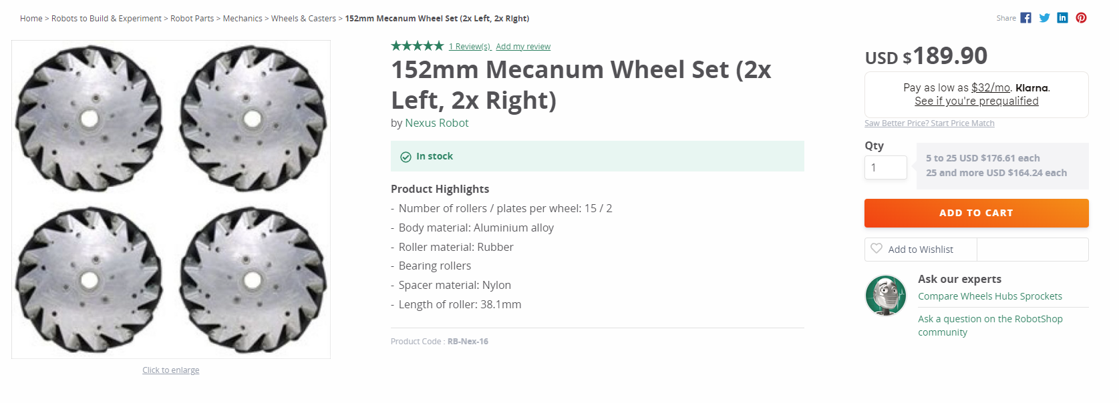
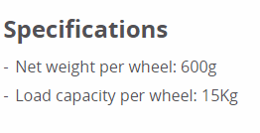
ii) Hardware Components
Mecanum Wheels (High Quality)
Brand : Nexus Robot
Price : RM 803

Slide 14
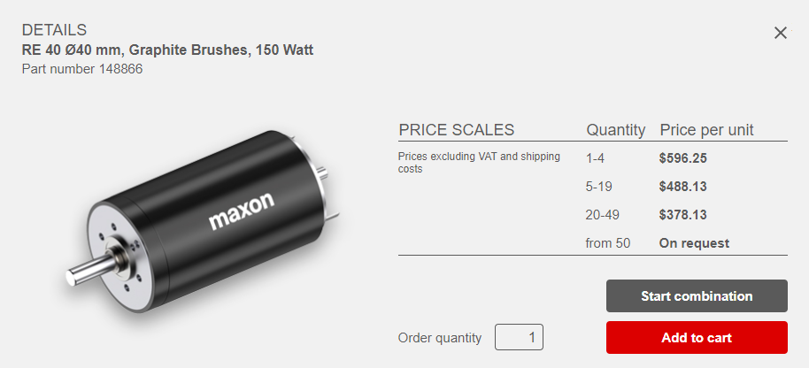
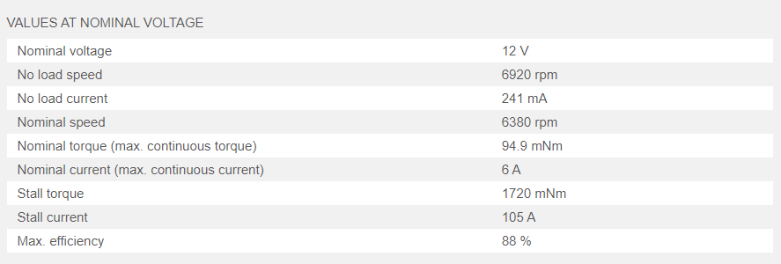
DC Servo Motor
Brand : Maxon
Price : RM 2500 per unit

Slide 15
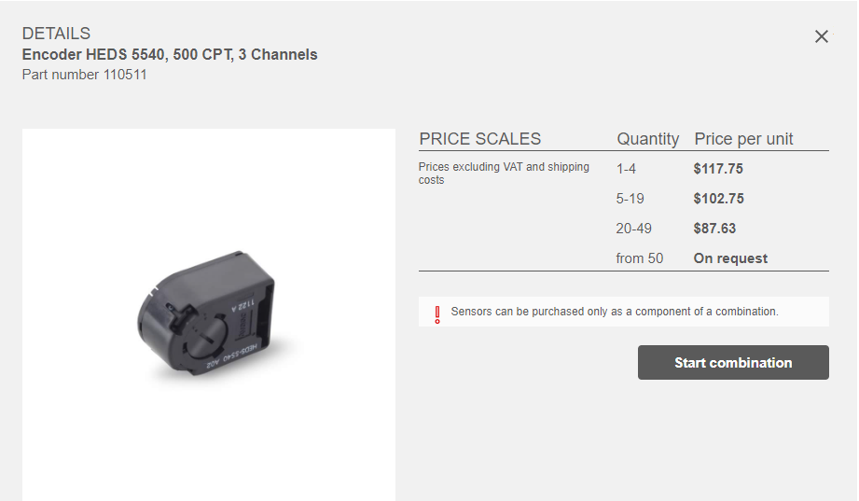
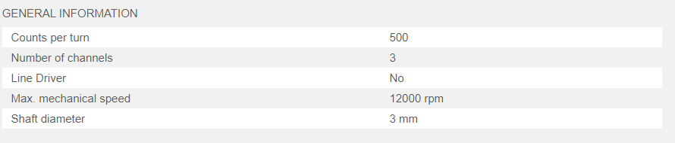
Motor Encoder
Brand : Maxon
Price : RM 500 per unit

Slide 16
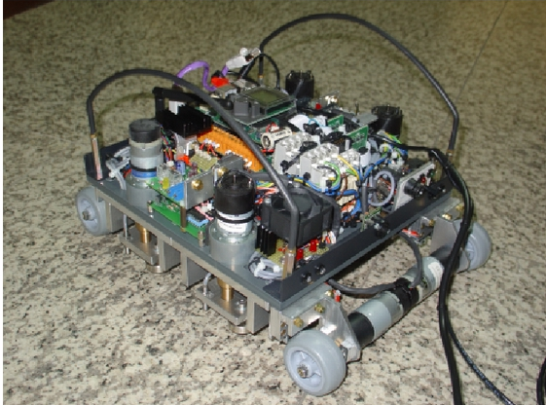
2) Wheeled Robots & Tracked Robots c) Wall Climbing Robot (Metal vs Wall vs Glass)

Slide 17
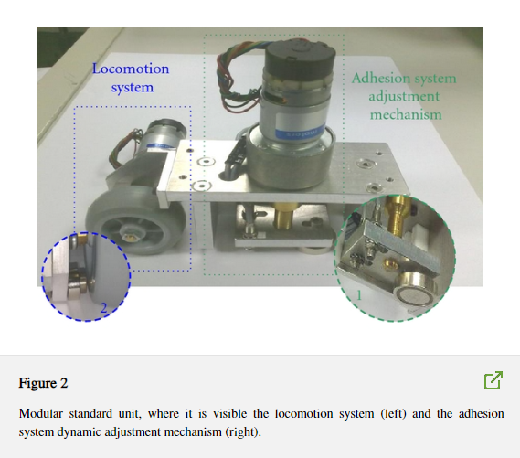
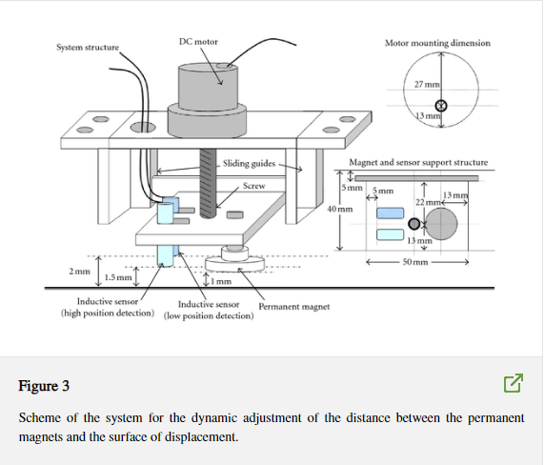
i) Basic Motion Principle
Wheeled Locomotion and Permanent Magnet Mechanism

Slide 18
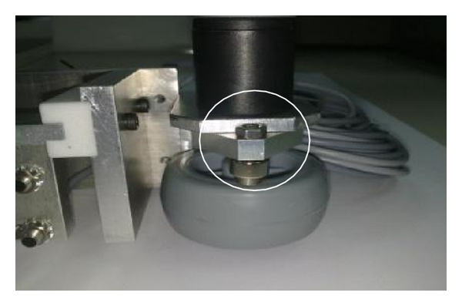
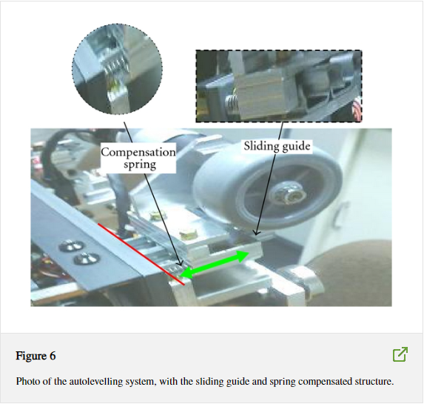
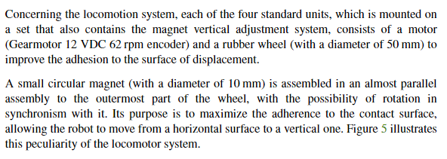
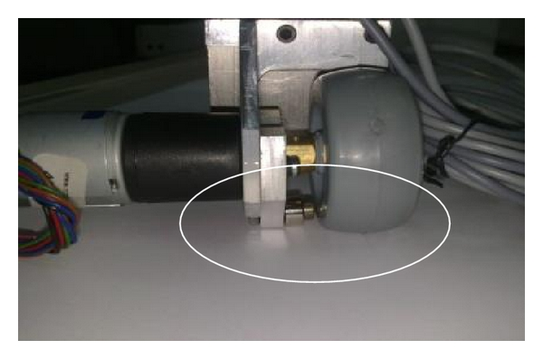
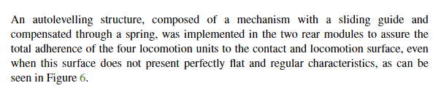

Slide 19
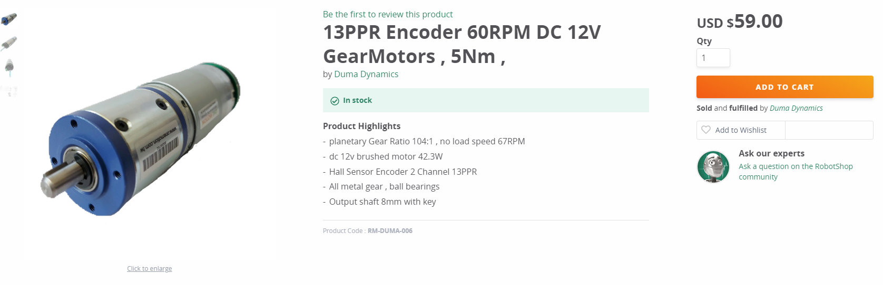
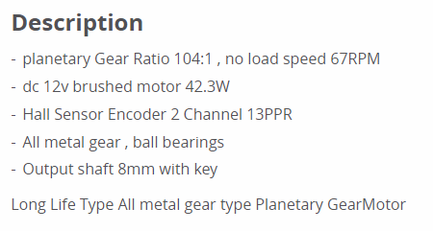
ii) Hardware Components
DC Motor
Brand : Duma Dynamics
Price : RM 250

Slide 20
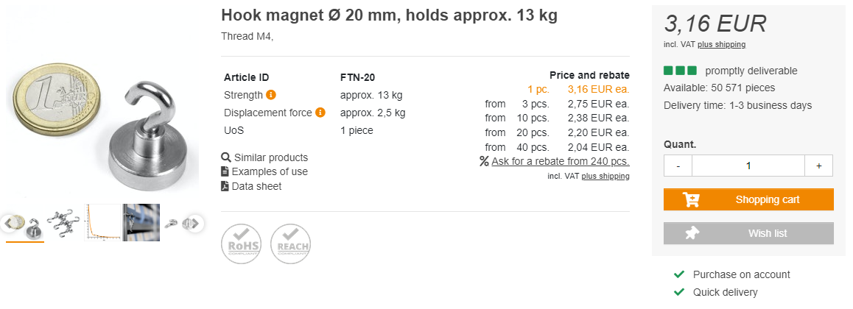
Permanent Magnet
Brand : Supermagnete
Price : RM 15/piece
The supermagnet is embedded on the inside and the outside of the rubber wheel

Slide 21
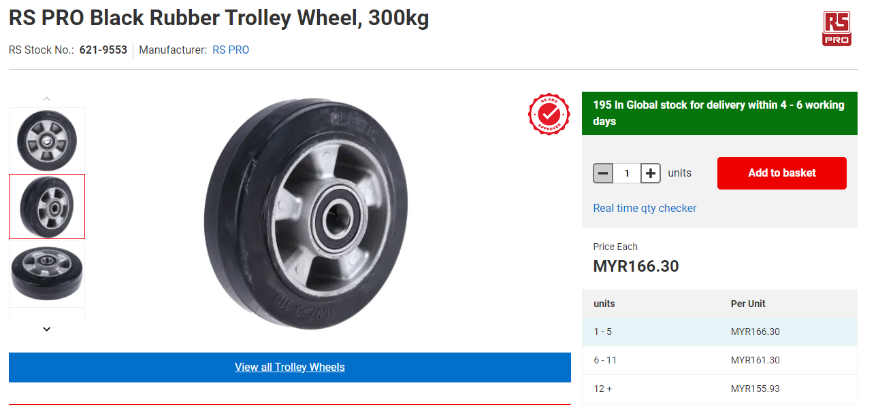
Rubber Wheel
Brand :RS Pro
Price : RM 166/piece

Slide 22
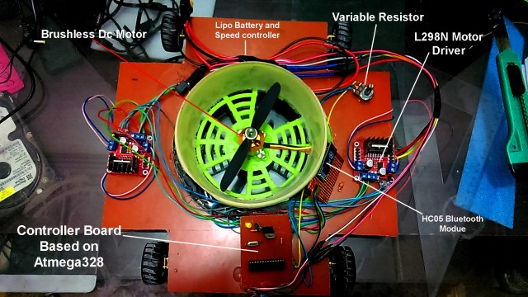
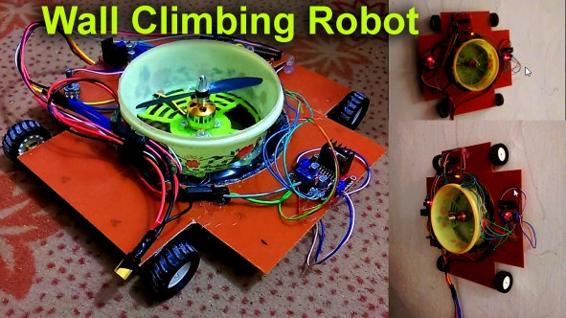
2) Wheeled Robots & Tracked Robots c) Wall Climbing Robot (Metal vs Wall vs Glass)
Wall Climbing Robot Car

Slide 23
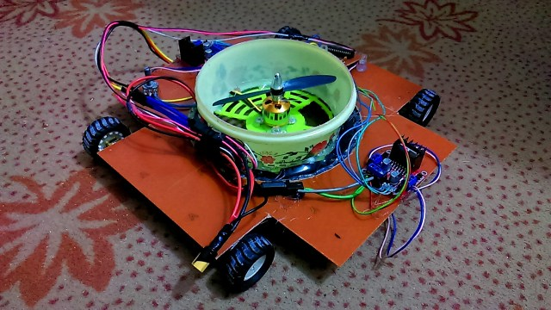
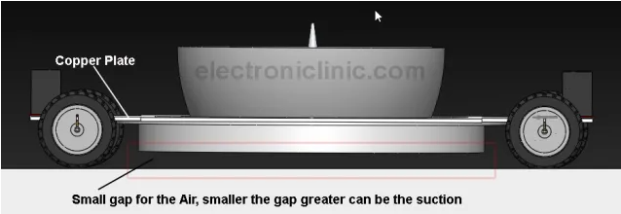
i) Basic Motion Principle
Vacuum Suction
The high RPM Quad Copter Brushless Dc Motor is used to create the vacuum by sucking the air due to which the Robot sticks to the wall. The smaller the gap between the copper plate and the ground, the higher the suction capability. As the quadcopters swing, the pressure will decrease. Air will always flow from a high-pressure area to a low-pressure area, to try to balance out the pressure. The rotating quadcopters forces air toward the exhaust port at a high speed, which lowers the pressure of the air inside, according to Bernoulli’s Principle. This creates suction – the higher pressure air from outside the vacuum rushes in through the intake port to replace the lower-pressure air. As a result, the robot can easily mount on the wall.

Slide 24
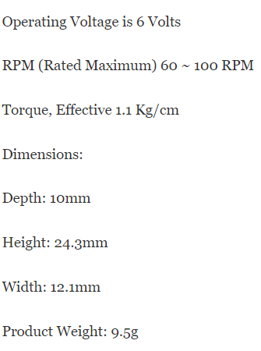
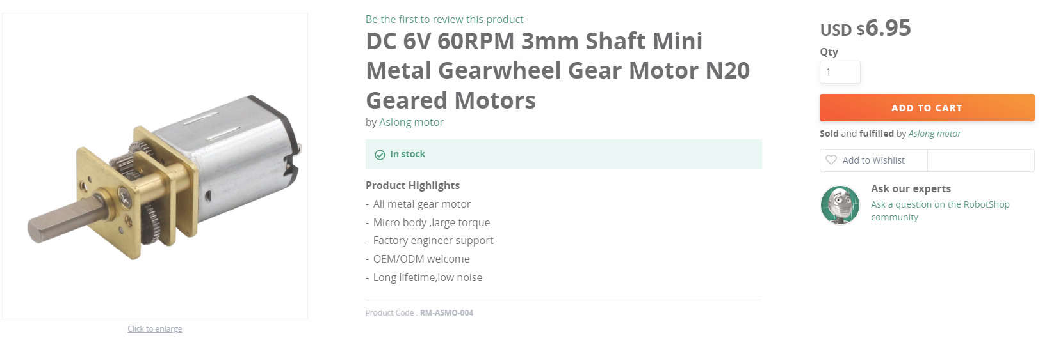
ii) Hardware Components
DC Motor (6V 60RPM)
Brand : Aslong Motor
Price : RM 30

Slide 25
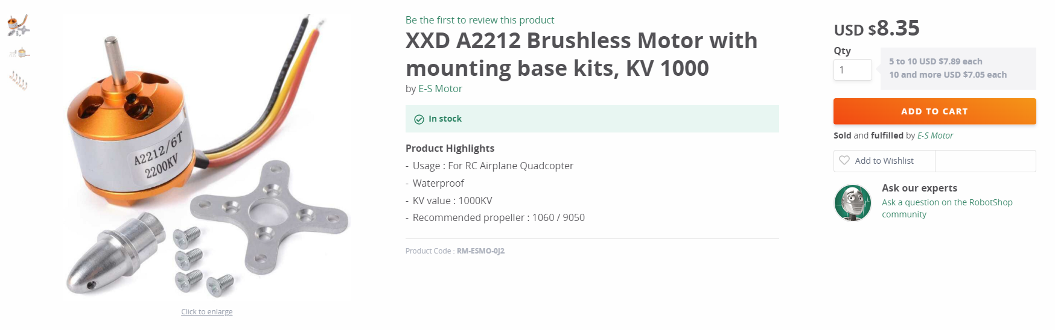
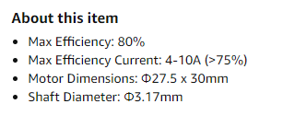
Brushless Motor (1000KV)
Brand : E-S Motor
Price : RM 35

Slide 26
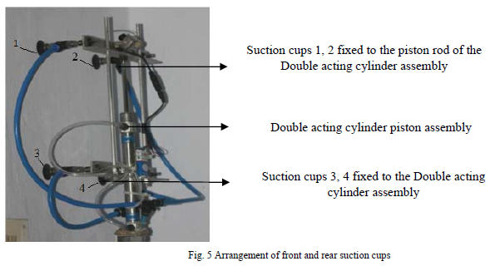
2) Wheeled Robots & Tracked Robots c) Wall Climbing Robot (Metal vs Wall vs Glass)
Pneumatics
based Wall Climbing Robot for Inspection
Applications

Slide 27
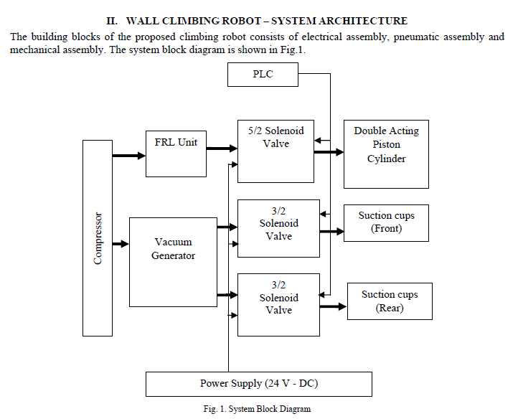

Slide 28
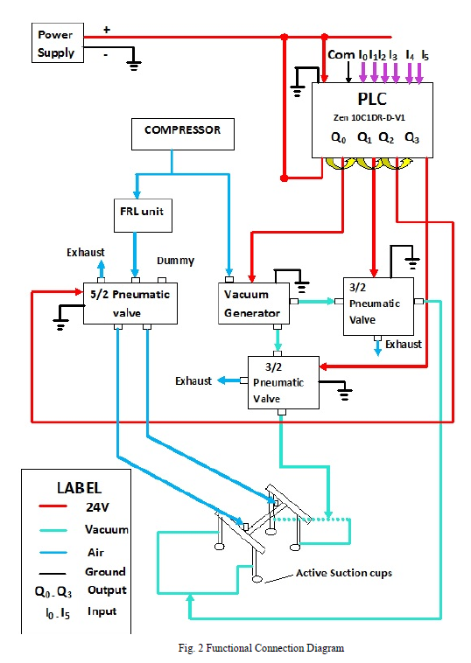
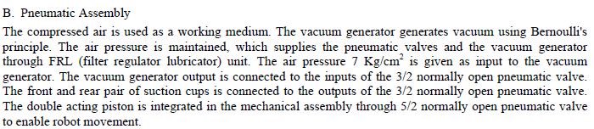
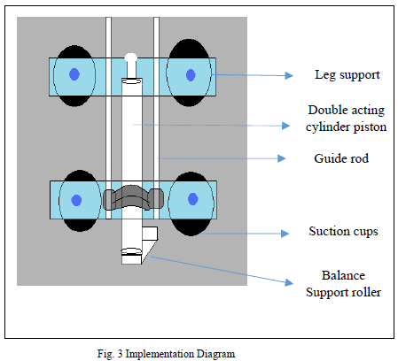

i) Basic Motion Principle
Suction Cups and Pneumatics Supply Cylinder

Slide 29


ii) Hardware Components
Solenoid Valves
Brand : RS Pro
Price : RM 318

Slide 30


Vacuum Generator
Brand : Numatics
Price : RM 226

Slide 31


Double Acting Cylinder
Brand : RS Pro
Price : RM 267

Slide 32

Suction Cup
Brand : Lynxmotion
Price : RM 21

Slide 33

3) Legged a) Humanoid Robot (BIOLOID)

Slide 34


i) Basic Motion Principle
Two-legged humanoid robot

Slide 35


ii) Hardware Components
Servomotors
Brand : Dynamixel
Price : RM 211

Slide 36

4) Swimming a) Fish robot

Slide 37




i) Basic Motion Principle
Fish Robot Locomotion

Slide 38


ii) Hardware Components
Waterproof Servomotor
Brand : FeeTech
Price : RM 258

Slide 39

4) Swimming b) Underwater glider robot
ROUGHIE UNDERWATER GLIDER ROBOT

Slide 40
i) Basic Motion Principle
ROUGHIE controls displacement by pumping water to an internal ballast tank. A TCS MG1000 micropump takes in water through the front cap into a 450mL cylinder ballast tank with piston. Position of the piston head is read with a draw-wire sensor that correlates to total displacement. A solenoid valve is in series with the pump to prevent free flow. Pitch, roll, and yaw are controlled with linear and rotary control masses. A plate constrained to linear longitudinal movement holds the batteries and rotary control mass. This is driven +/- 2.5 inches from center by a Dynamixel servo using a gear and rack system. For rotary control, a brass weight cantilever hangs from another servo and can swing as a pendulum to roll the glider. The rotary mass is partially coupled with the linear mass since it rides along the same plate as the linear control mass.

Slide 41
ii) Hardware Components
Servomotors
Brand : Dynamixel
Price : RM 211

Slide 42

5) Others a) Kilobot

Slide 43

i) Basic Motion Principle

Slide 44


ii) Hardware Components
Coin Vibration Motor
Brand : SeedStudio
Price : RM 5

Slide 45



TCS MG1000 Micropump
Brand : TCS Micropumps
Price : RM 1250

